Slide 1
Capstone Project :4
Online Retail Customer Segmentation

Slide 2
Understanding Business Problem
→ Topic – “Online Retail Customer Segmentation”
→ Problem Statement :
“In this project, your task is to identify major customer segments on a transnational data set which contains all the transactions occurring between 01/12/2010 and 09/12/2011 for a UK-based and registered non-store online retail. The company mainly sells unique all-occasion gifts. Many customers of the company are wholesalers”.
-> Target is to know our customer, and maximize the profit of the retail company

Slide 3
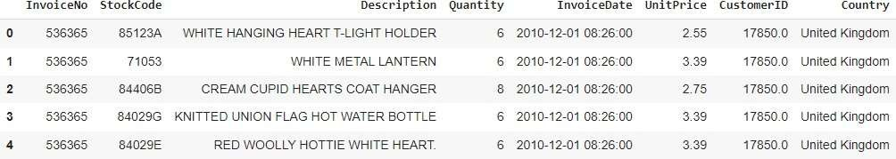
Dataset Information
→This dataset contains 541909 observations and 8 features that contain the data of between
01/12/2010 and 09/12/2011 for a UK-based and registered non-store online retail.
There are 3 categorical features in our dataset.
This dataset have null and duplicate values.

Slide 4
Feature Summary
InvoiceNo: Invoice number. Nominal, a 6-digit integral number uniquely assigned to each
transaction. If this code starts with letter 'c', it indicates acancellation.
StockCode: Product (item) code. Nominal, a 5-digit integral number uniquely assigned toeach
distinct product.
Description: Product (item) name. Nominal.
Quantity: The quantities of each product (item) per transaction. Numeric.
InvoiceDate: Invoice Date and time. Numeric, the day and time when each transaction was
generated.
UnitPrice: Unit price. Numeric, Product price per unit in sterling.
CustomerID: Customer number. Nominal, a 5-digit integral number uniquely assigned toeach customer.
Country: Country name. Nominal, the name of the country where each customer resides.

Slide 5
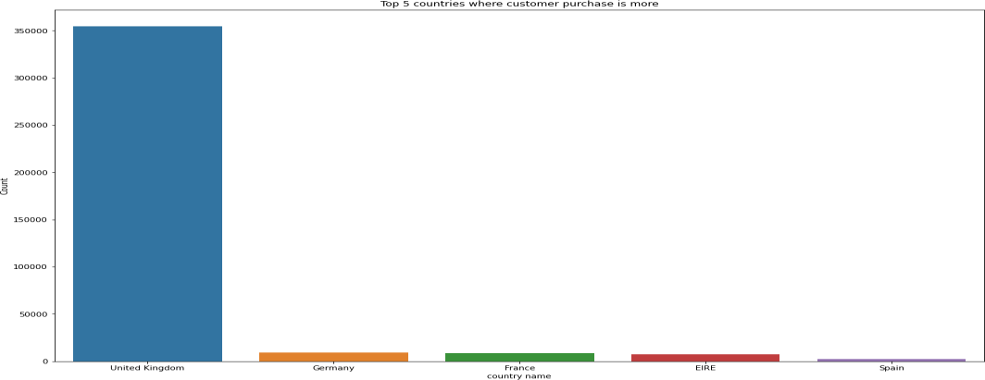
Categorical Feature Analysis Of Country column

Slide 6
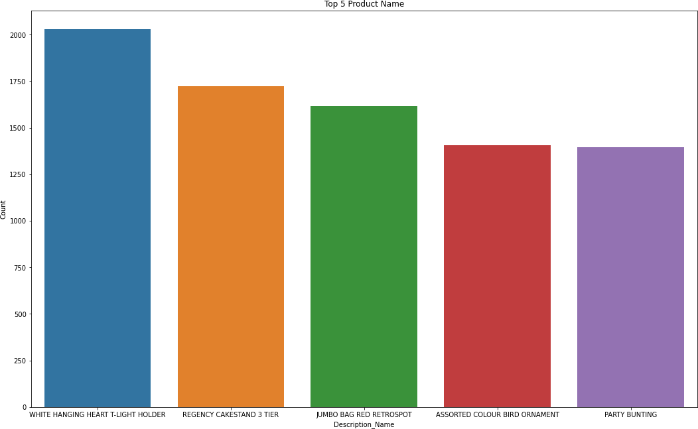
Analysis Of Product column

Slide 7
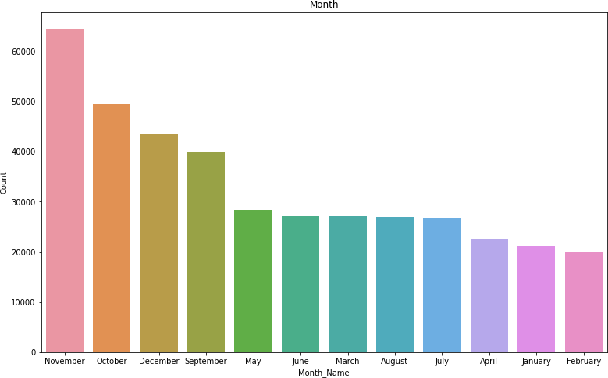
Analysis Of Month Column

Slide 8
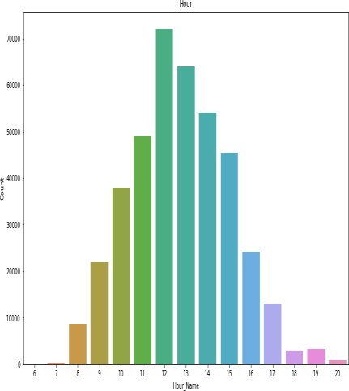
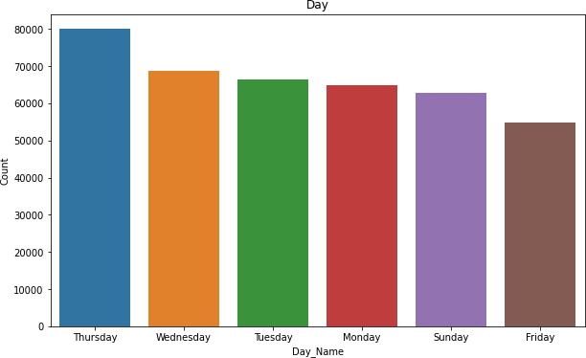
Analysis Of Day Column

Slide 9
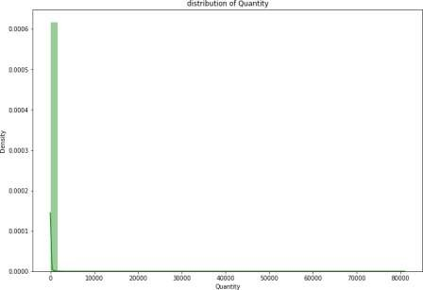
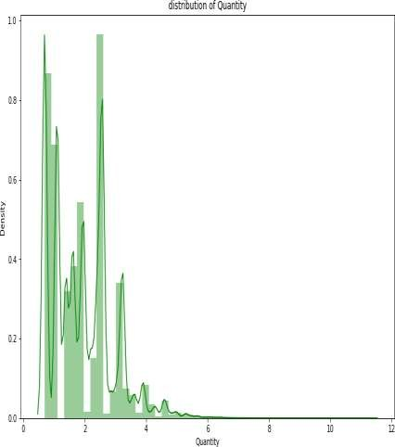
Analysis Of Numerical column
Data transformation

Slide 10
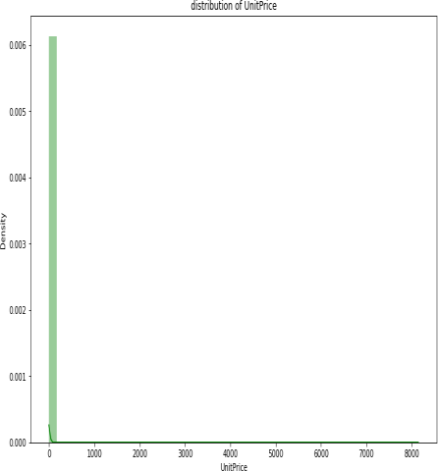
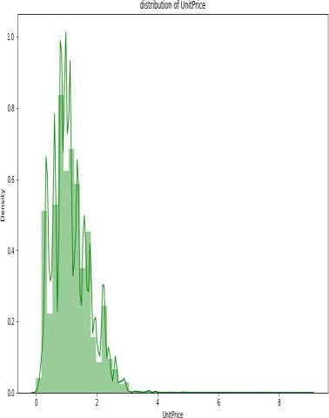
Analysis Of Numerical column
Data transformation

Slide 11
Conclusion
We can conclude that most of the customers have purchase the items in Thursday Wednesday and
Tuesday
The most numbers of customers have purchase the gifts in the month of November ,October and December September
Most of the customers have purchase the items in Afternoon ,moderate numbers of customers have
purchase the items in Morning and least numbers of customers have purchase the items in Evening
Top countries with respect to purchase are UK Germany France
Top Items are WHITE HANGING HEART T-LIGHT HOLDER,REGENCY CAKESTAND 3 TIER JUMBO BAG RED RETROSPOT ASSORTED COLOUR BIRD ORNAMENT

Slide 12
RFM Segmentation
RFM stands for Recency, Frequency, and Monetary. RFM analysis is a commonly used technique to generate and assign a score to each customer based on how recent their last transaction was (Recency), how many transactions they have made in the last year (Frequency), and what the monetary value of their transaction was (Monetary).
RFM analysis helps to answer the following questions: Who was our most recent customer? How many times has he purchased items from our shop? And what is the total value of his trade? All this information can be critical to understanding how good or bad a customer is to the company.
After getting the RFM values, a common practice is to create ‘quartiles’ on each of the metrics
and assigning the required order.

Slide 13
RFM Implementation
RFM simply mean Recency, Frequency, Monetary
The RFM model is based on three quantitative factors
Frequency: How often a customer makes a purchase.
Monetary Value: How much money a customer spends on. (Sum of Total)
Recency = Latest Date - Last Invoice Data
Split into four segments using quantiles

Slide 14
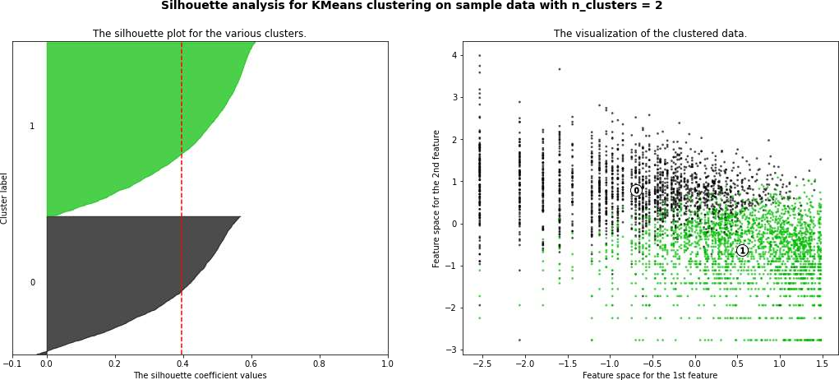
K mean clustering and Silhouette Method on Recency
,Frequency and Monetary

Slide 15
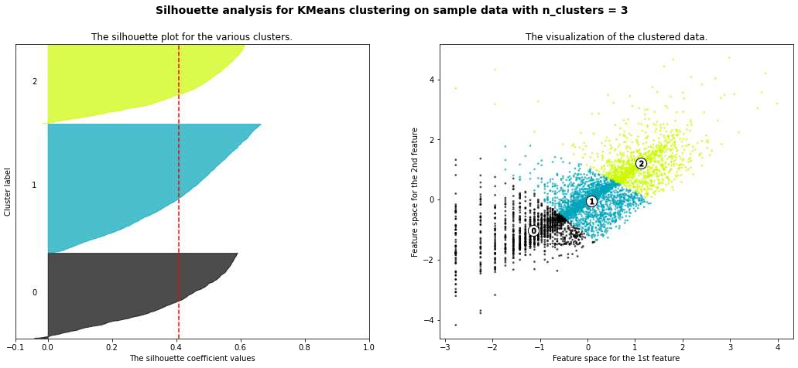

Slide 16
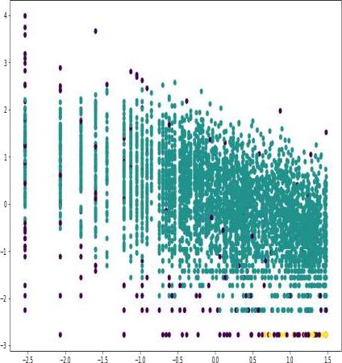
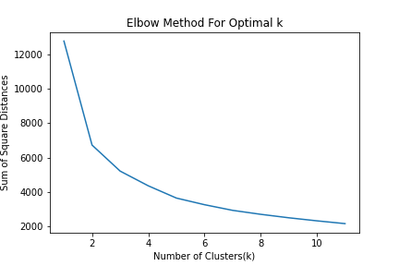
DBSCAN and Elbow method to Recency Frequency and Monetary

Slide 17

Conclusion
Although we didn't obtain two clearly separated clusters, we were able to build a model that can classify new customers into "low value" and "high value" groups. Generally, if a customer only transacted with us a few times, they needed to be at least in the top 50th percentile in monetary spending to be considered a "high value customer".
K-Means with silhouette_score of RFM Optimal_Number_of_cluster are 2
K-Means with Elbow methos of RFM Optimal_Number_of_cluster are 2

Slide 18


Challenges
Large Dataset to handle
Need to analyze lot of variable
Null value handling
Feature engineering
Selecting Optimum number of cluster
Deciding the flow of the presentation

Slide 19
Thank you

